Slide 1
Voalte UI/UX
Creating value-added user experience

Slide 2
Importance of UI/UX
“Unless you can really compete on price you better find another way to differentiate yourself. That other way is design.”
—
Dmitry Fadeyev, Value of Good Design, usabilitypost.com

Slide 3

Our Story
“Listening to our customers and developing software that’s life-changing and life-saving is how we roll. From conception of the idea to delivery of our latest product, we focus on our customers every step of the way. In an industry where companies too often settle for being “good enough,” we think you deserve better.”

Slide 4

#1 from 10 things we know to be true
Focus on the user and all else will follow.

Slide 5
Design & Usability Evaluation Metrics
Design Tricks
Apple’s iOS Human Interface Guidelines
Aesthetic Integrity
Consistency
Direct Manipulation,
Feedback
Metaphors
User Control
Google’s Material Design & Usability
Principle: clear,robust, and specific
Color & Contrast
Sound
Motion
Layout
Writing
Hierarchy & Focus
Implementation
Nielsen’s Usability Heuristics
Visibility of system status
Match between system and the real world
User control and freedom
Consistency & standards
Error prevention
Recognition rather than recall
Flexibility and efficiency of use
Aesthetic and minimalist design
Help users recognize, diagnose, and recover from errors.
Help and Documentation
Notes:
“UI is just a matter of opinions and colors” - NOT TRUE!
Objective ways to evaluate in-app end-user experience
Nielsen and the 2 most popular mobile ecosystem.
Users should NEVER ‘relearn’ a system.
Questions?

Slide 6
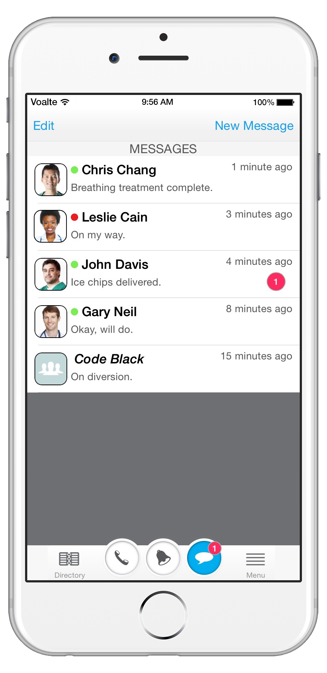
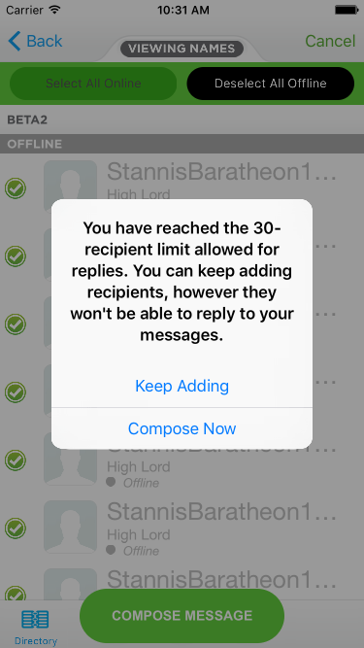
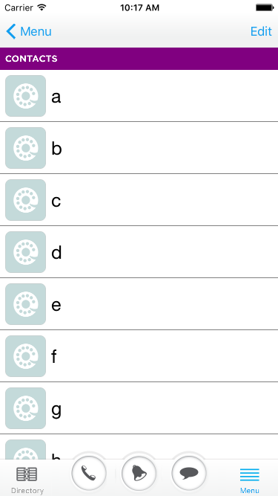

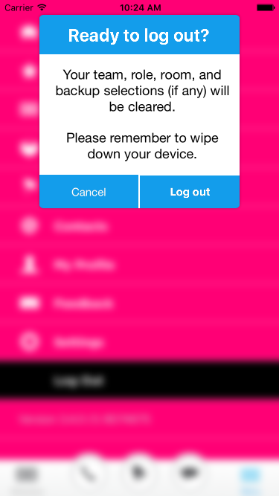
Current User Experience
A typical user-flow

Slide 7
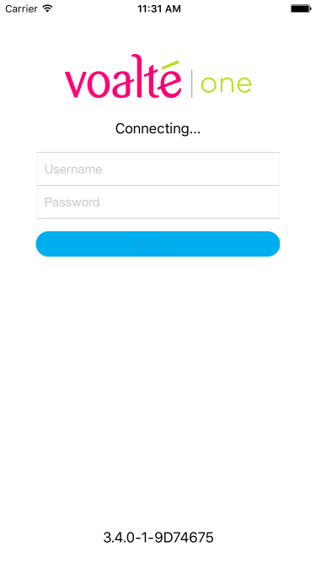
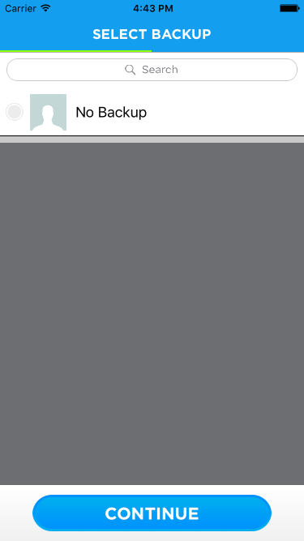
Voalte User Flow - Onboard

Slide 8
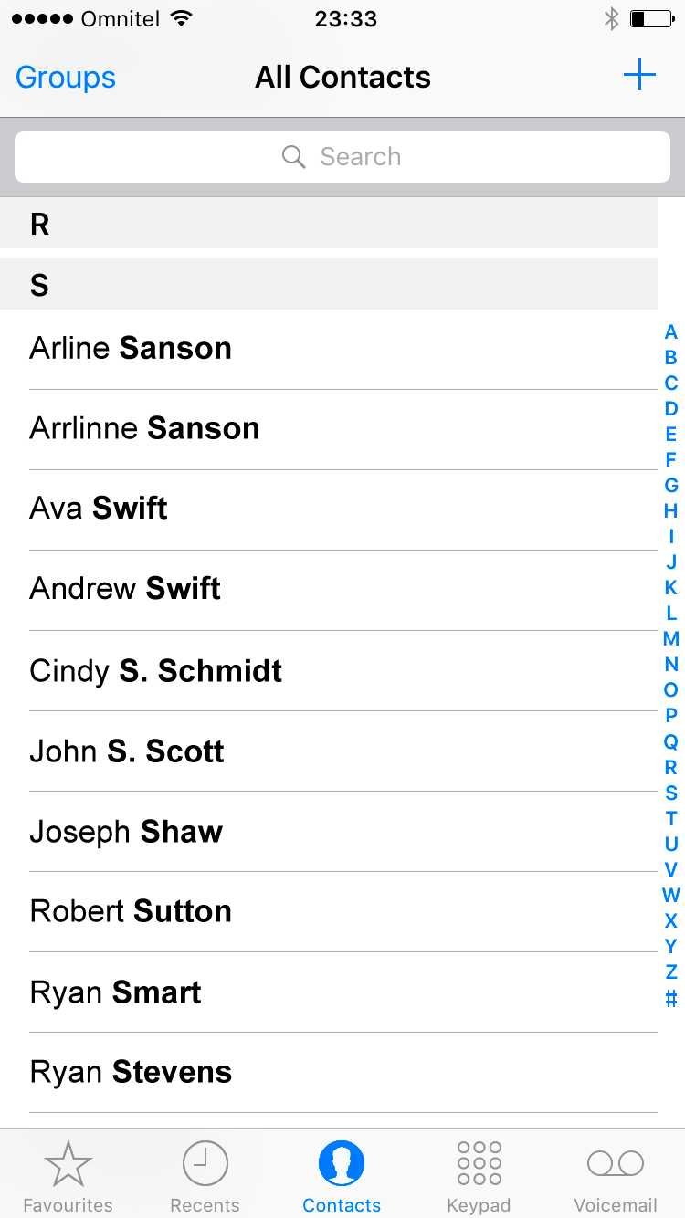
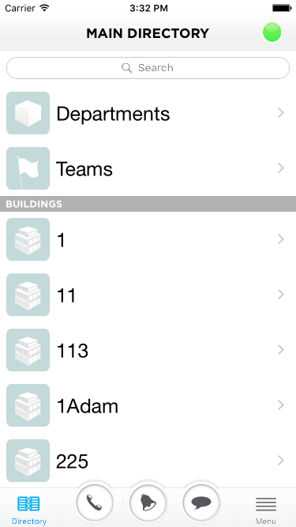
Home/Main Directory View

Slide 9
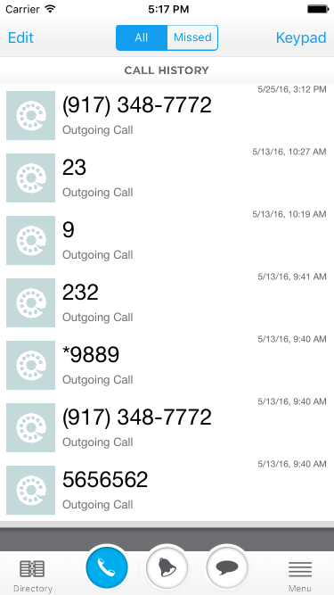
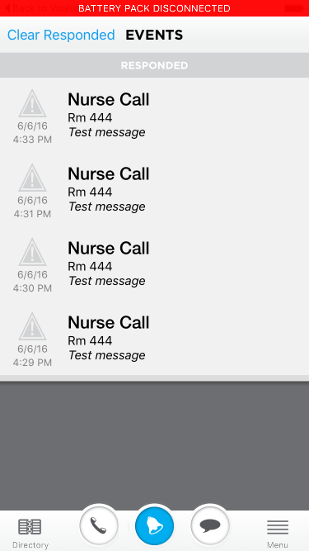
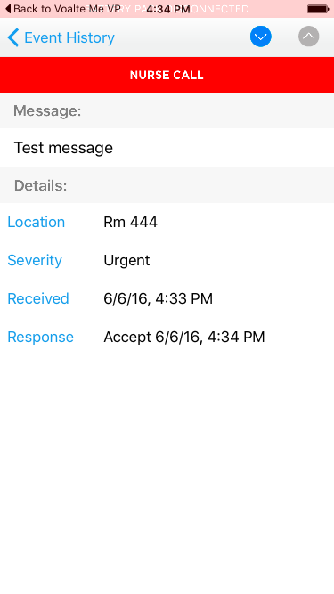
Core Features

Slide 10
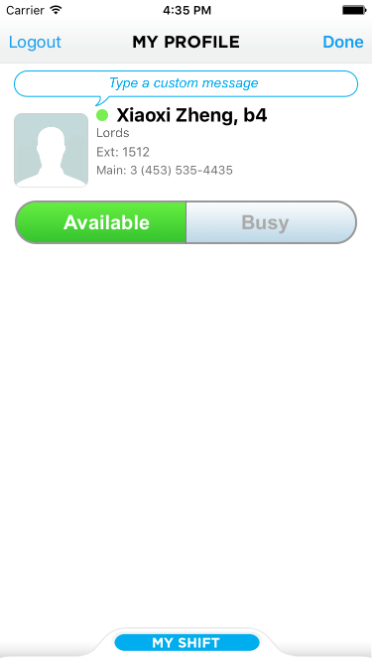
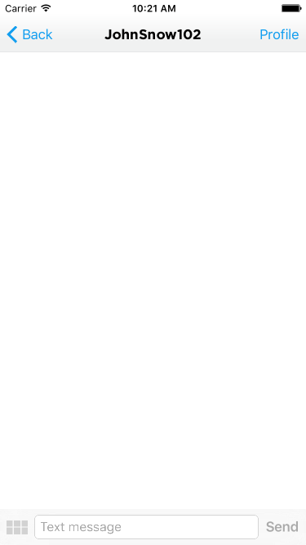
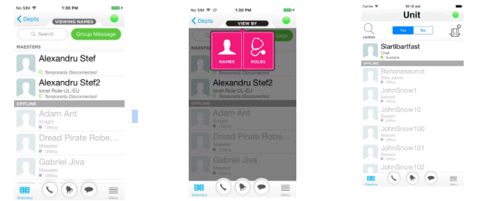
Potentially Unused Features

Slide 11
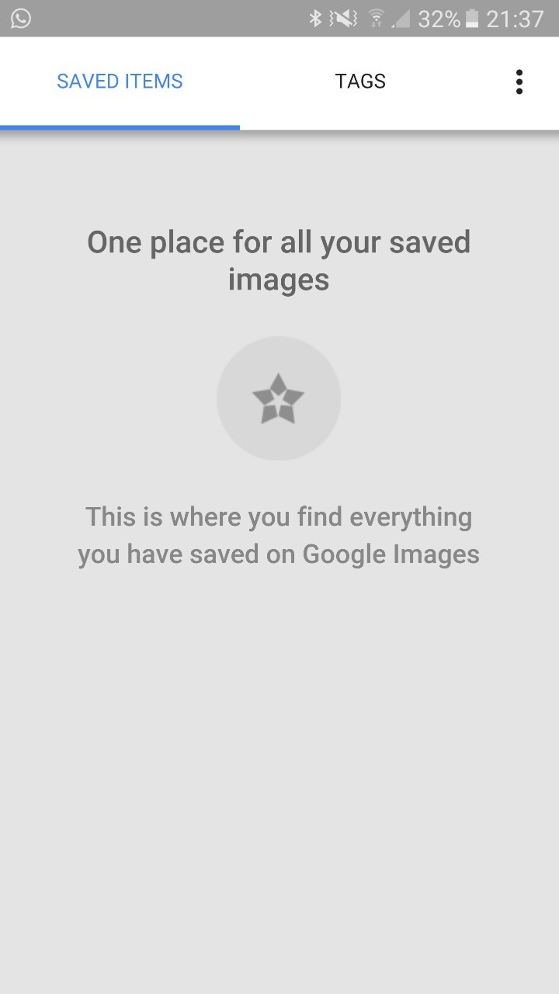
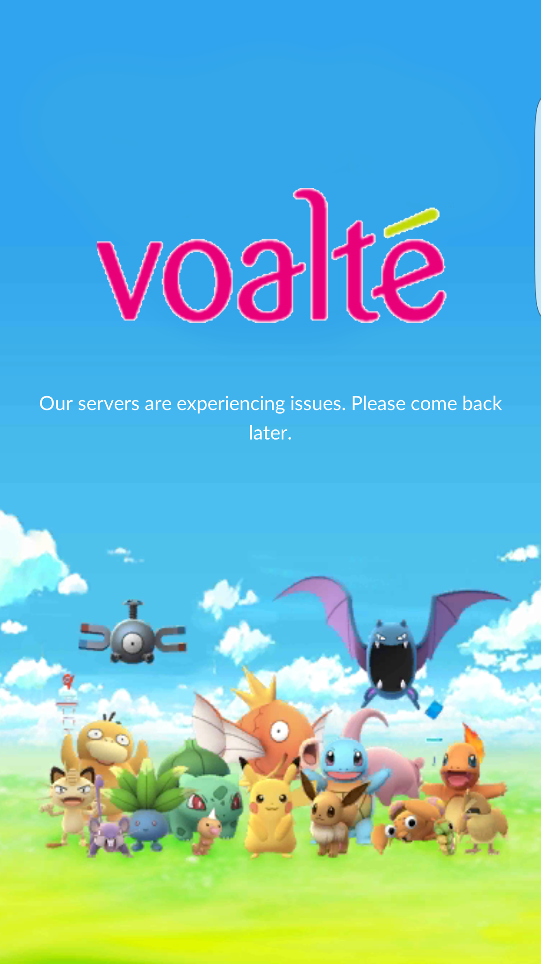
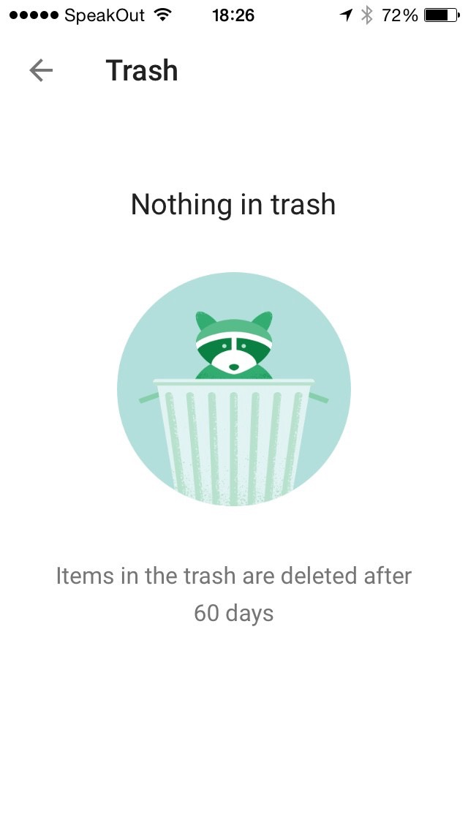
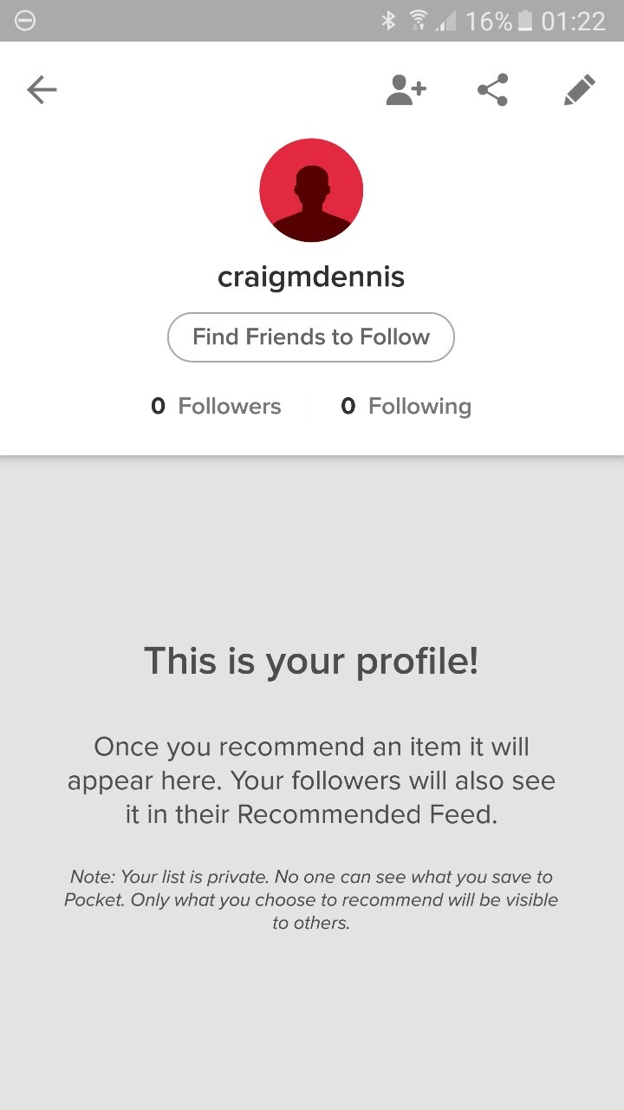
Empty States and Error Prevention

Slide 12
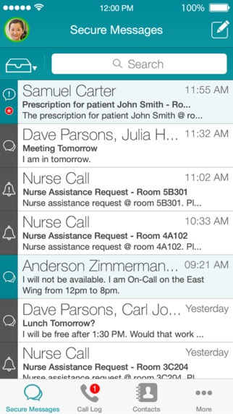
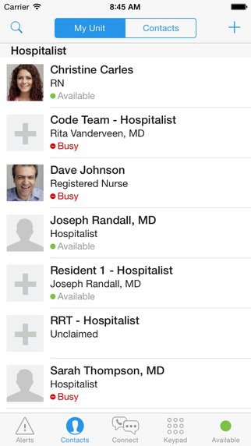
Competitor’s Designs
Vocera Collaboration Suite
Cerner CareAware Connect

Slide 13
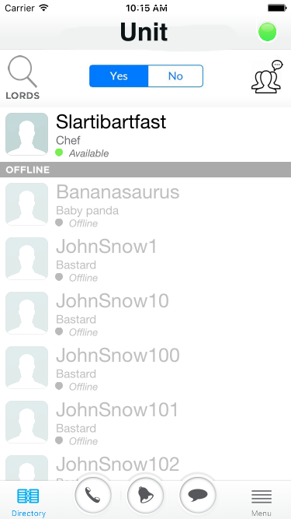
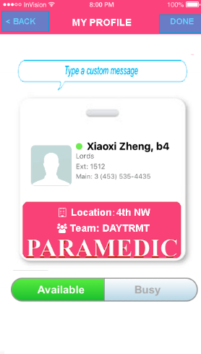
Updated UI/UX
inVision Prototype

Slide 14
Looking forward
Creating “Human Goals”
Iterative Design
Problem identification
How do you know it’s a real problem?
What data, anecdotes, etc. lead you to believe this?
Why solve this problem over others?
You have limited resources and time — why apply them to this problem above all else?
Hypothesis
Defining success & roadblocks
Making testable hypothesis
Test, Collect, Observe behaviors
Refine

Slide 15
Potential new features
Voice messages
Voice messages is a feature widely popular with app like Wechat/Line and currently is implemented by Apple’s default message app.
React to Text/Voice Messages
Intuitive “quick response”

Slide 16
Questions?
Xiaoxi Zheng
- iOS Engineering Intern

Slide 17


Slide 18
Smart Wearable Product
“We’ve seen an explosion of apps that do help “replace” the pager already for iPhone and Android. Most of these apps have not been transformative, but if they were able to utilize the Apple Watch they could completely disrupt the ecosystem”
- iMedicalApps

